Slide 1

The era of Netflix Project team: Ahmad Abo Alafa Loic Tiemani Hazim Hamadne Hamid Zarringhalam

Slide 2
Purpose of the Project
In this project we have analyzed Netflix Movies and TV shows based on their Ratings, Countries, Budgets, and Revenues.
https://www.kaggle.com/shivamb/netflix-shows?select=netflix_titles.csv
The kind of data we worked with is Netflix data till year 2019
Data Enrichment using these the following data sources:
Public movie APIs:
OMDB - OMDB to obtain information and metadata about movies.
http://www.omdbapi.com/?apikey={api_key}&t=
TMDB - TMDB for movie discovery.
https://api.themoviedb.org

Slide 3
questions we have asked of the data
Graph of the countries that contribute producing movies for NetFlix
Network analysis of Actors / Directors and find interesting insights
Is Netflix has increasingly focusing on TV rather than movies in recent years.
Using API to enrich the movies data getting more information about the movie such as Reviews, Rating, top rated, the budget for the Movie and the total money that the movie has generated
Top rated movies

Slide 4
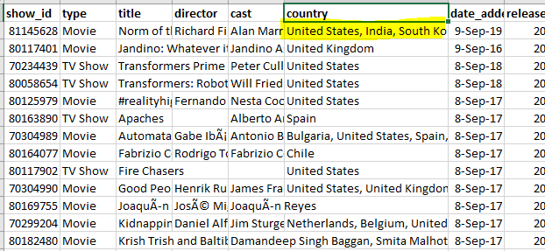
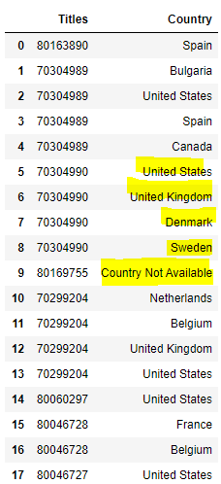
Data preparation:

Slide 5
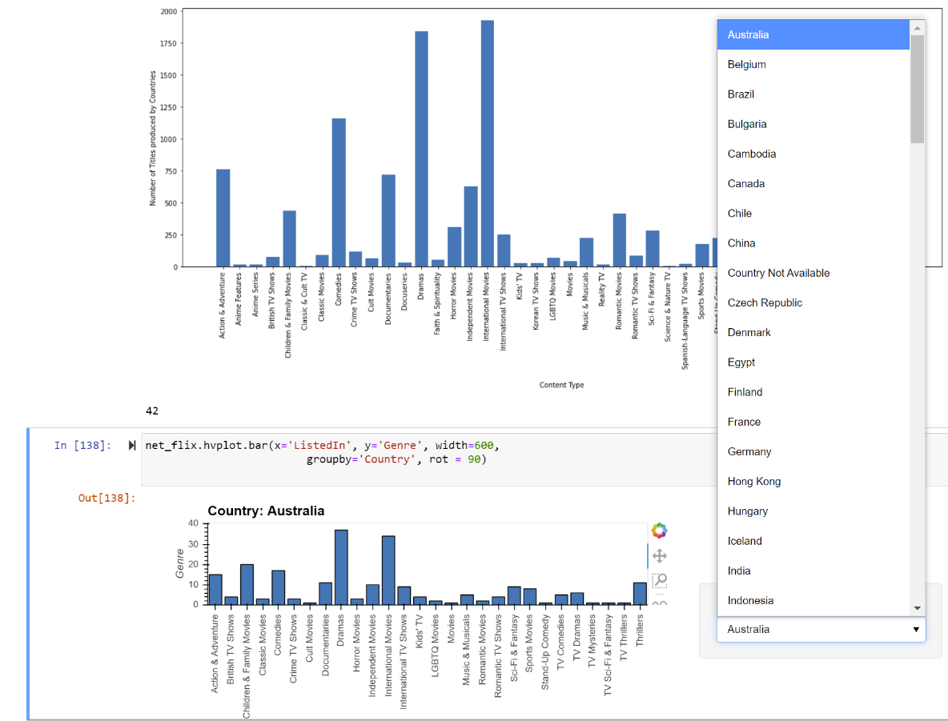
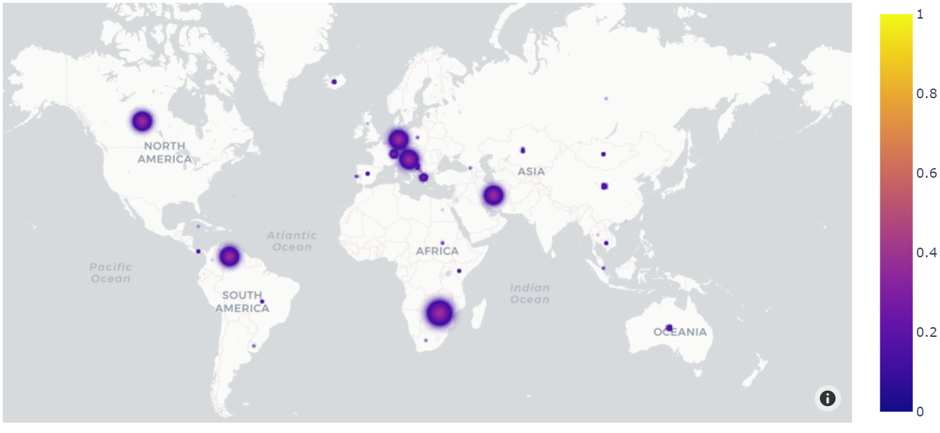
Graph of the countries that contribute producing movies for NetFlix
import hvplot.pandas
import plotly.express as px

Slide 6
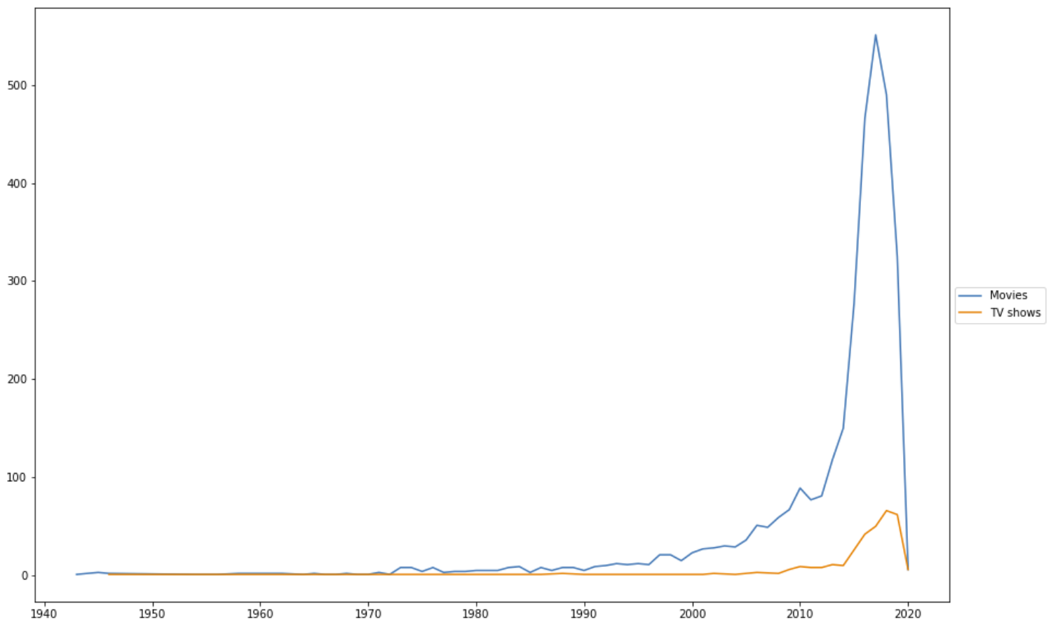
Is Netflix has increasingly focusing on TV rather than movies in recent years?
Graph is showing that NetFlix is adding more TV Shows recently.
However, NetFlix is still focusing on movies.

Slide 7
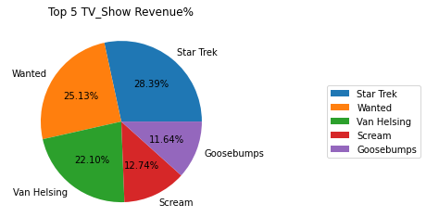
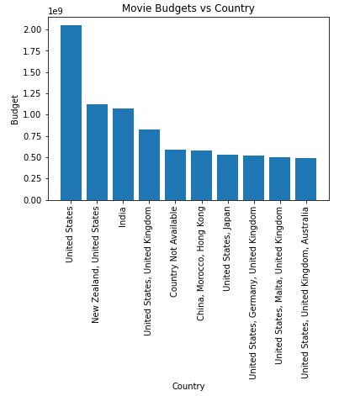
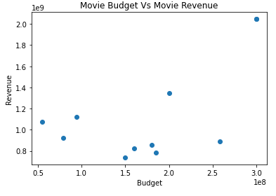
Using API to enrich the data getting more information about the movie & TV Shows such as Reviews, and Budget

Slide 8
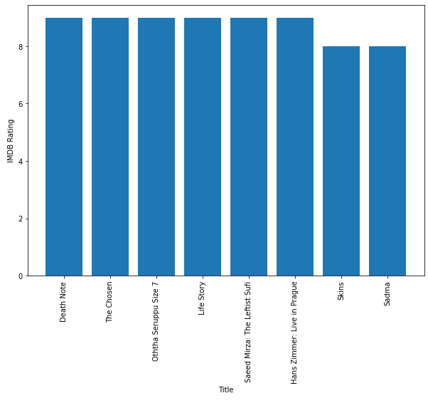
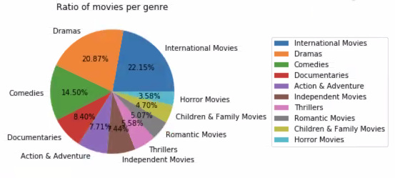
Using API to enrich the data getting more information about the movie & TV Shows such as tOP IMDB ratings, Distribution of Movies vs Genre

Slide 9
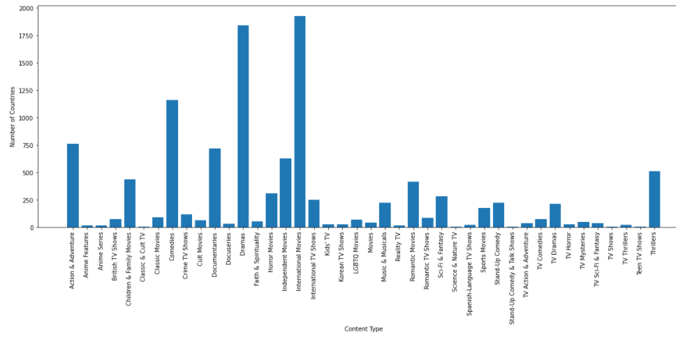
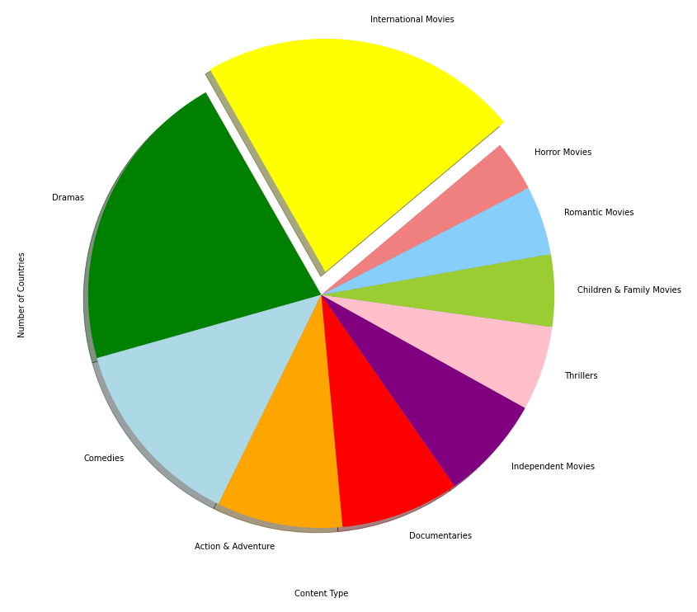
Using API to enrich the data getting more information about the movie & TV Shows such as Content type & Number of Countries

Slide 10
Challenges
Missing Data and no access to some resources
Historical Data before 2016 is not available
Future Plans
Migrating data to SQL DB
Use more sources to fill the missing data.
Prepare the data to be published in the Web
Use machine learning to correlate and analyze the data.

Slide 11
Thank you

